Slide 1
Now that this cutie has your attention!
Parent information session for OVS juniors
PRESENTED BY: SCHOOL COUNSELING DEPARTMENT​ - MR. ARRINGTON, MS. MORGAN, & MS. VERGON

Slide 2
MEET YOUR COUNSELORS
Mr. Arrington: 12th Grade Counselor
Mrs.Morgan: Odd Grades Counselor
Mrs. Vergon: Blended student counselor

Slide 3
How do I make an appointment with the counselor?
You can email us or sign up for an appointment anytime online!
Schedule Time with Katelyn Morgan at:
https://outlook.office365.com/owa/calendar/KatelynMorganOVS@osceolak12.onmicrosoft.com/bookings/
Schedule Time with Christopher Arrington at:
https://calendly.com/arringtc

Slide 4
Join us on Remind!
HOW TO GET CONNECTED AND KNOW WHAT IS COMING UP DURING YOUR JUNIOR YEAR

Slide 5
What you should know?
Requirements for graduation in 2024.
How to help them research college and careers on Xello
How to help them with college applications
How to help with essays and resumes
How to help get the financial support needed
Junior year is for research and senior year is for action.

Slide 6
GRADUATION REQUIREMENTS
LANGUAGE ARTS - 4 CREDITS
MATHEMATICS – 4 CREDITS
(Algebra&Geo&2more)
SCIENCE – 3 CREDITS(Biology, 2 rigorous)
SOCIAL STUDIES – 3 CREDITS -WORLD HISTORY – 1
-AMERICAN HISTORY – 1
-AMERICAN GOV’T – .5
-ECONOMICS - .5

Slide 7
GRADUATION REQUIREMENTS
Physical Education –
Pers. Fitness/Team Sports-1
World Languages/
Electives– 8
24 TOTAL CREDITS FOR GRADUATION

Slide 8
Assessment Requirements for Graduation 2024
FAST or FSA Reading- level 3 or above
Algebra 1 – pass class, pass EOC for credit, 30% of grade
Geometry – pass class- EOC is 30% of grade
Biology-pass class- EOC is 30% of grade
U.S. History-pass class- EOC is 30% of grade
FCLE- Florida Civic Literacy Exam- all students enrolled in a U.S. Government course in high school to take the assessment

Slide 9
Grade Point Average
Weighted GPA
Grade=Quality Pts.
AP & D E Honors
A = 5.0 4.5
B = 4.0 3.5
C = 3.0 2.5
D = 2.0 1.5
Unweighted GPA
Grade=Quality Pts.
A = 4.0
B = 3.0
C = 2.0
D = 1.0
F = 0.0

Slide 10
Senior Year… It can seem scary…
Students will have many ups and downs
Students may need about +$1000 to cover all expenses of high school and the college process
Yearbook
Cap and Gown
College application fees
Test fees
Housing deposits
Enrollment deposits
Prom
Universal’s Senior Graduation event

Slide 11
What can you do as the parent/guardians?
Remind them they still must get good grades and study in their Junior and Senior year.
Keep communication OPEN​
Listen to what they want – about college​
Listen for uncertainty, lack of confidence etc.​
Help them to be realistic and boost confidence​
Take them to visit colleges; virtual visits​ or face to face
Remind them about tests and deadlines – help them make a calendar and keep a college folder ​
Be prompt with any pieces you must complete i.e., this year’s tax returns to use for next year’s FAFSA

Slide 12
When you can help……
NOW – help student do research about careers and determine the selection criteria for college.
Career Research- Xello
College selection criteria includes:
Major /Degrees offered
Location (in- state vs. out of state)
Size (how do you learn?)
Financial aid opportunities / cost
Admissions requirements
Good college website for parents – Big Futures at Collegeboard.org

Slide 13
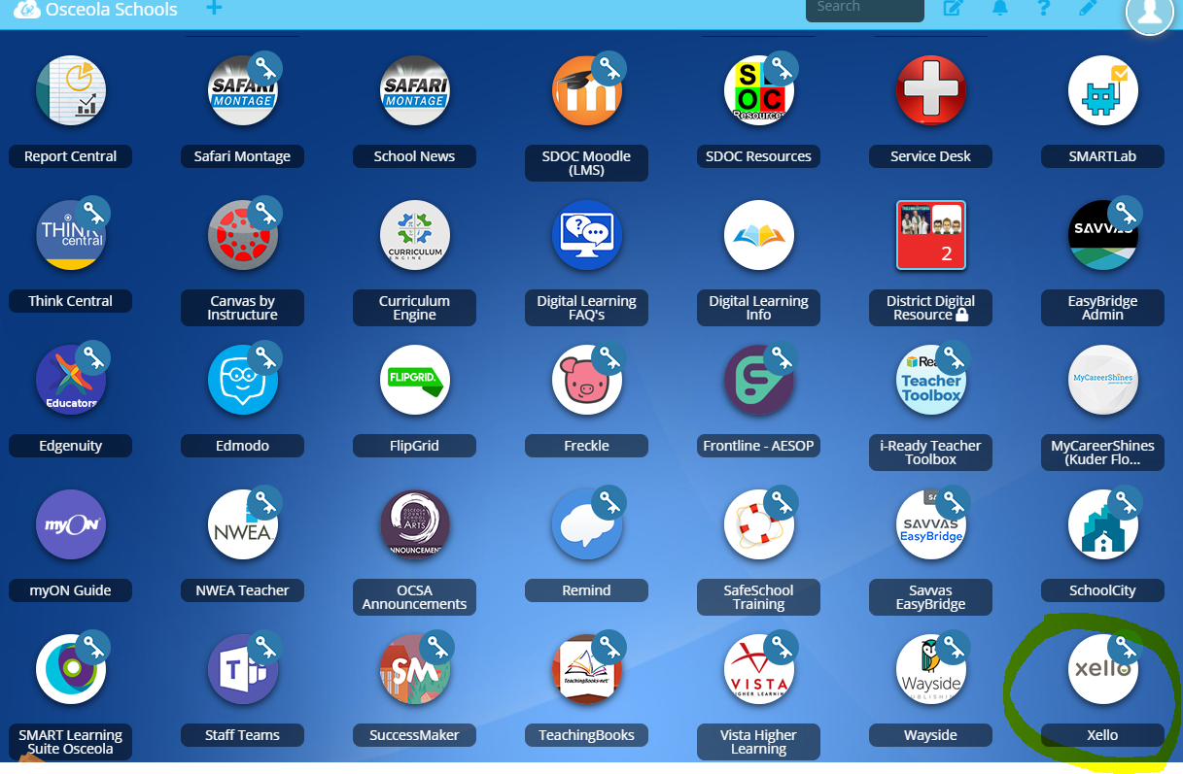
Xello is a free tool that all Osceola County School for the Arts student have. You can take career assessments, research careers and colleges, use it for goal setting, upload and save documents and so much more!

Slide 15
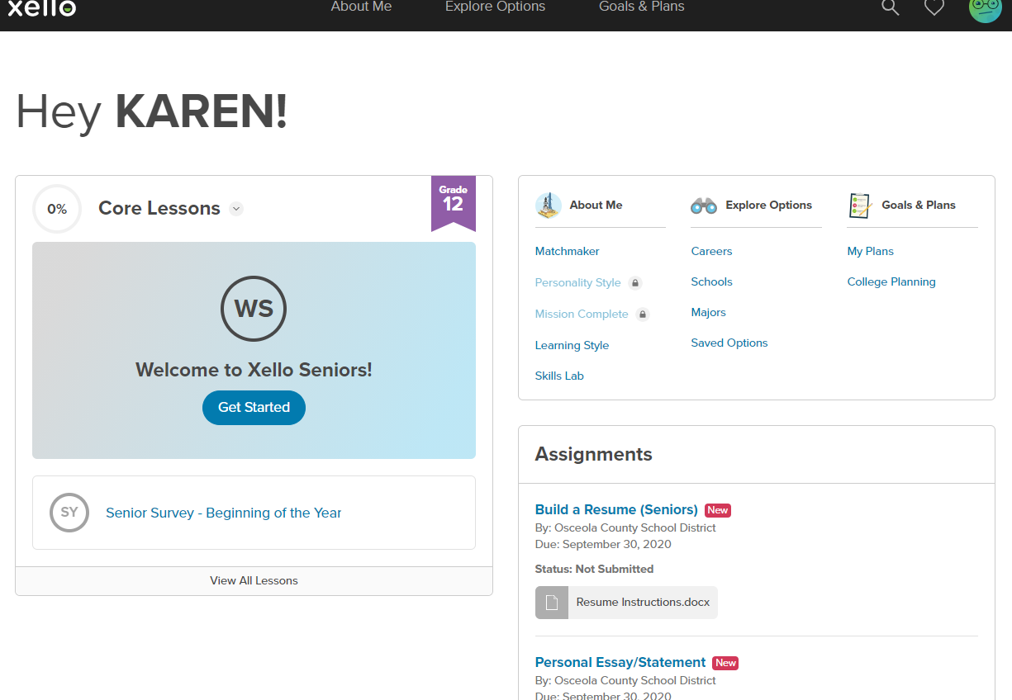
Students can access
Lessons
List colleges applying to
Request transcripts
Explore careers, schools, majors
Assignments

Slide 16
College and Career Resources-District

Slide 17
Tips
Understand what the college is looking for: Have a plan B.
Be sure all parts of the application are complete and submitted; extra pair of “eyes”
SPELLING and GRAMMAR are important!!!!!
Proofread essays and have someone else proofread before submit
Treat every application like your first choice
Meet your deadlines!
Subscribe to our REMIND texts for information AND READ THEM!

Slide 18
Tips
Attend college fairs: make contact with admissions personnel
Research admissions and scholarship requirements
NO SCHOOL IS FOR EVERYBODY AND EVERYBODY IS NOT FOR EVERY SCHOOL. Have REACH and MATCH schools.
Take process seriously but keep things in perspective: there are over 4,000 colleges in the U.S.
Colleges look for rigorous classes and upward trends, quality of involvement, strong test scores a predictor of how may do you 1st year of college

Slide 19
During the Summer
Visit colleges either in person or via internet www.collegeview.com for selection
www.ecampustours.com for viewing colleges.
Allow student to be a part of college summer programs
Allow student to get an internship (paid or unpaid)
Get all information together for application process in September

Slide 20
Questions!?!?
Comments?!!?
Concerns?!?

